Slide 1



AX/FINANCE & OPS
San Antonio, Texas
October 13-17, 2024

Slide 2
Boosting Financial Teamwork in Finance and Operations & Power Platform

Slide 3






Kelly Gustafson
VP of Microsoft Practice
Microsoft MVP
Nathan Clouse
Technical Architect
Microsoft MVP

Slide 4
Welcome and Session Overview
Collaboration Challenges in Finance [Kelly]
The Microsoft 365 and Dynamics 365 Path to Integration [Nathan]
Automating Finance Workflows within D365 and/or Power Automate [Nathan]
Enhancing Visibility with Power BI [Kelly]
Success Stories
Recap and Q&A

Slide 5
Collaboration Challenges in Finance

Slide 6


Do collaboration challenges in
Finance have you feeling frustrated?

Slide 7
Common collaboration challenges
Communication – or lack thereof
Workflow bottlenecks
Need for insight into data
Disconnected processes, or lack of standard processes
Disconnected systems impacting decision making and productivity

Slide 8
Common collaboration challenges
Data silos
Miscommunication – sometimes in remote or hybrid work environments
Resistance to change

Slide 9
The Microsoft 365 and Dynamics 365 Path to Integration

Slide 10
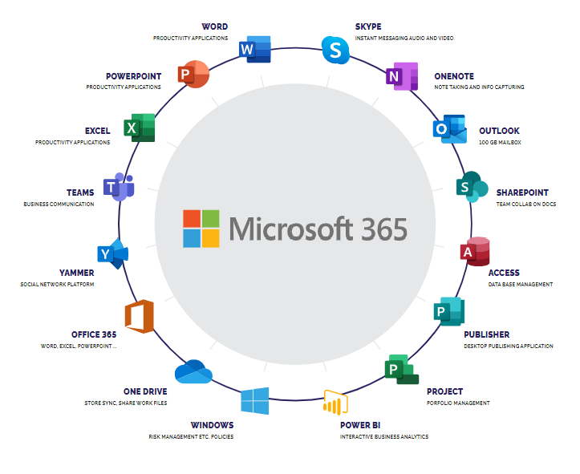
M365

Slide 11
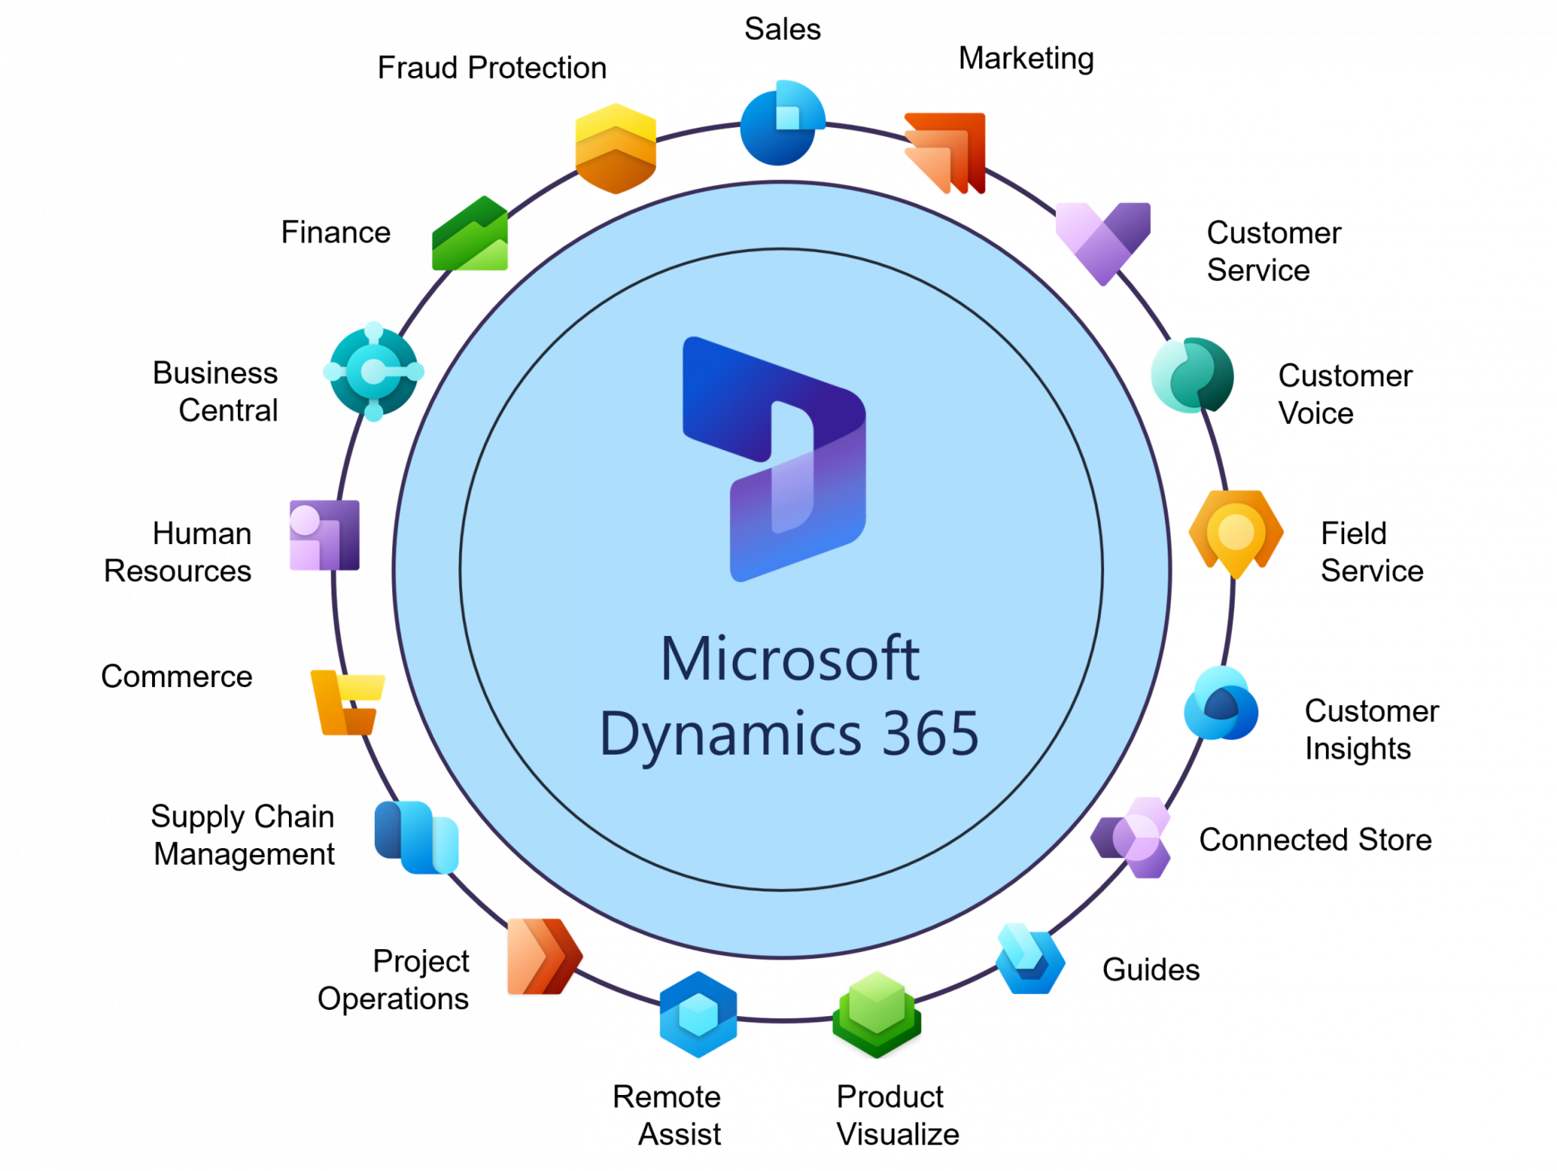
D365

Slide 12
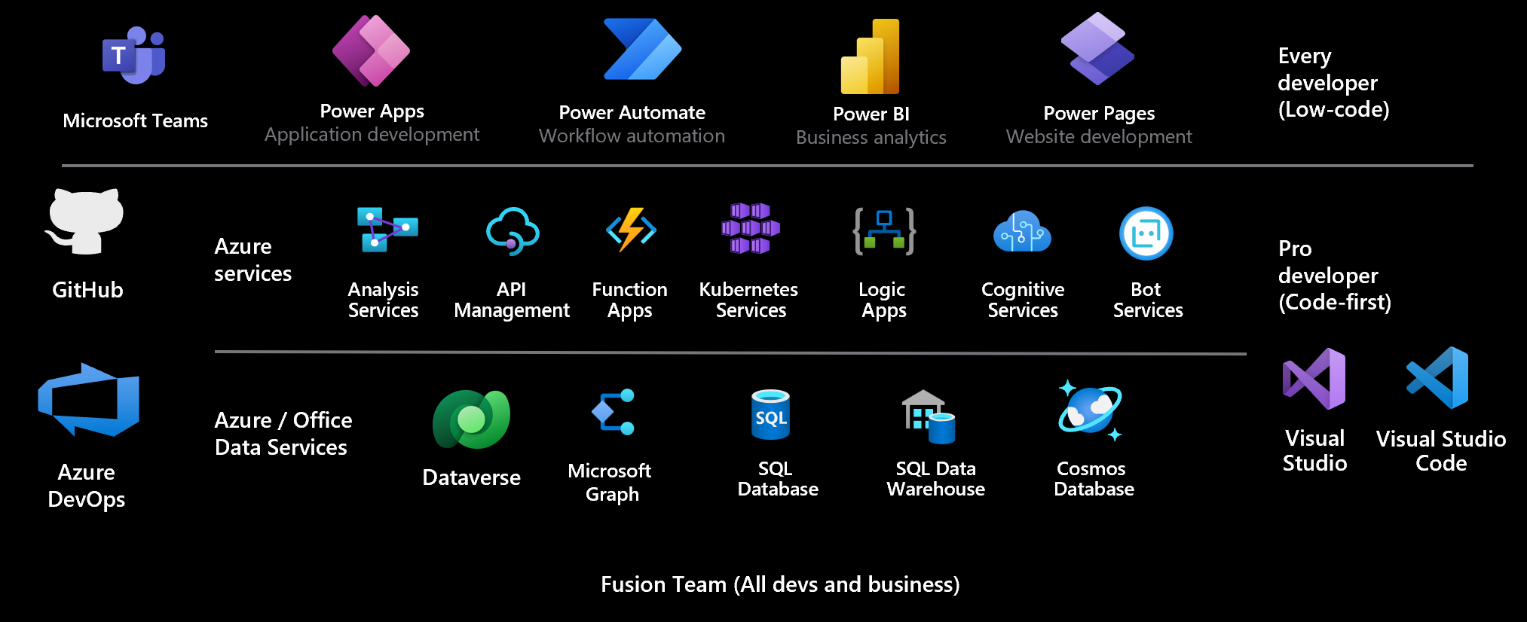
Power Platform

Slide 13
What can they do?
“Better Together”
Stitch together various interactions to make your life easier
Something happened so do something ( loop until you get the desired result )

Slide 14
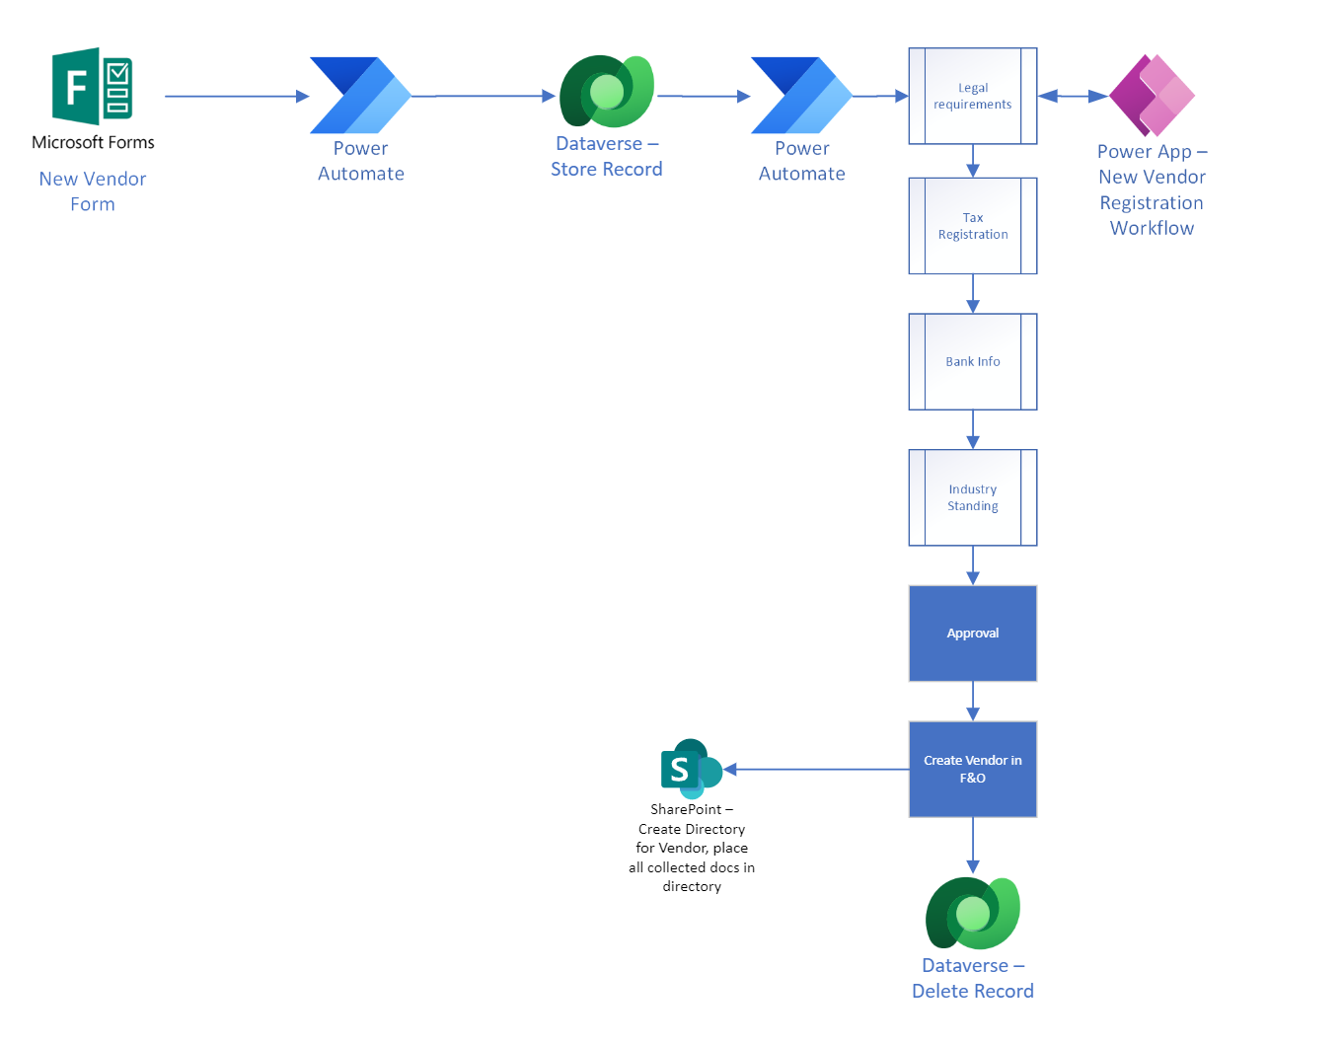
Example

Slide 16
Example

Slide 17
Automating Finance Workflows within D365 and/or Power Automate

Slide 18
Streamlining Processes
What can be formalized into a workflow?
Can that workflow be automated?
Can that be set to report and raise exceptions?
Can AI help?

Slide 19
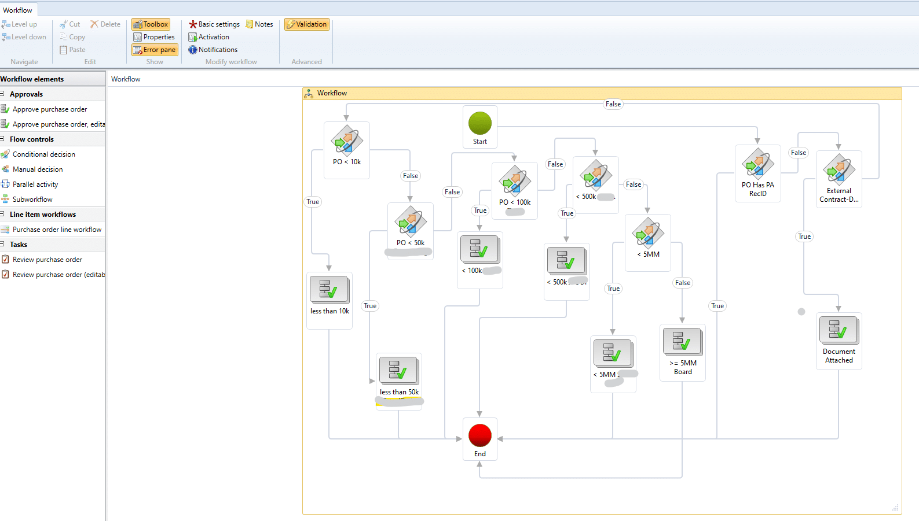
Workflow
Notes:
https://stoneridgesoftware.com/use-workflows-in-dynamics-365-finance-and-operations-to-strengthen-your-financial-process/

Slide 20
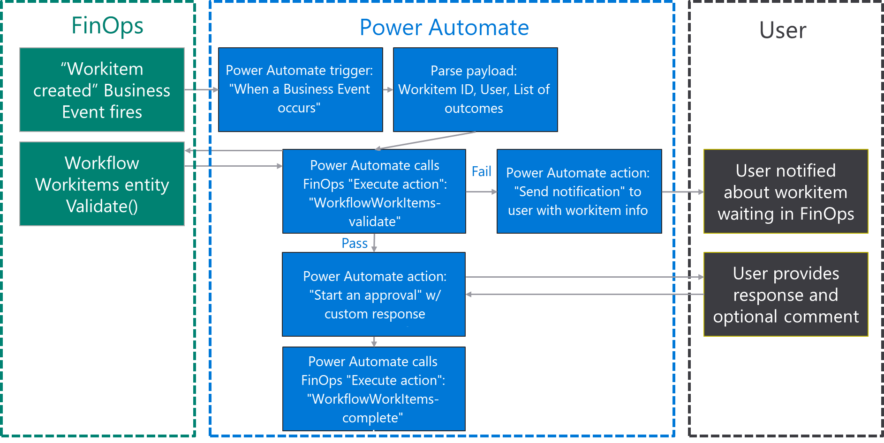
Workflow

Slide 21
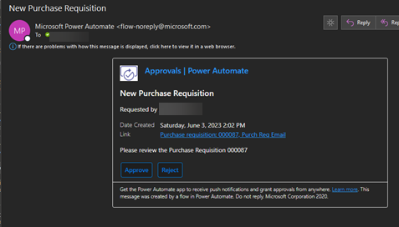
Workflow - Email

Slide 22
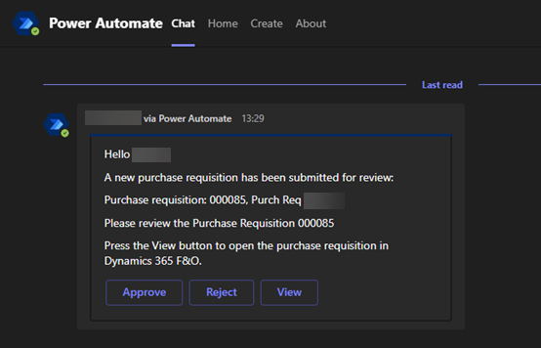
Workflow - Teams

Slide 23
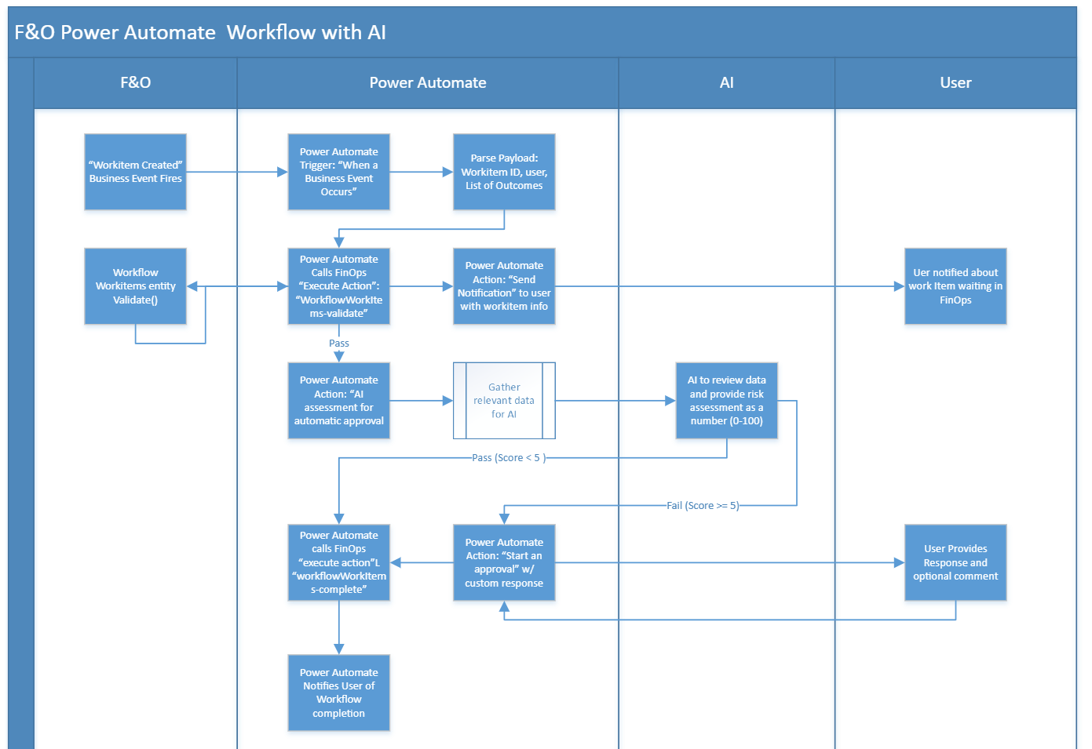
Workflow with AI

Slide 25
Workflow with AI

Slide 26
Enhancing Visibility with Power BI

Slide 27

Power BI
Dashboards are a single page, or canvas, that tells a story with data
Because it’s one page, it has to tell the highlight reel
Visualizations on a dashboard are presented in tiles that show data in different formats

Slide 28
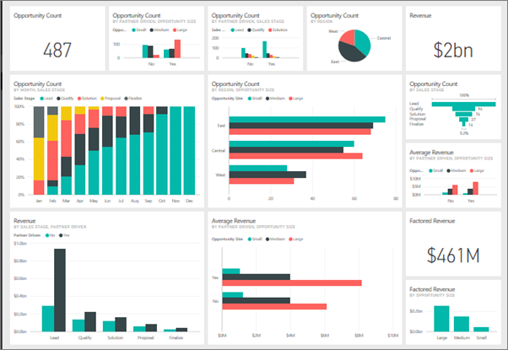
Power BI

Slide 29
Power BI
Dashboards are fed by reports that are populated by datasets
Data can be shown in real-time
Reports an be customized to meet your organizations needs

Slide 30
Business Performance Analytics
NEW reporting tool that allows for financial reporting in Power BI
Several Out of the Box reports available
No additional licensing costs AT THIS TIME

Slide 31
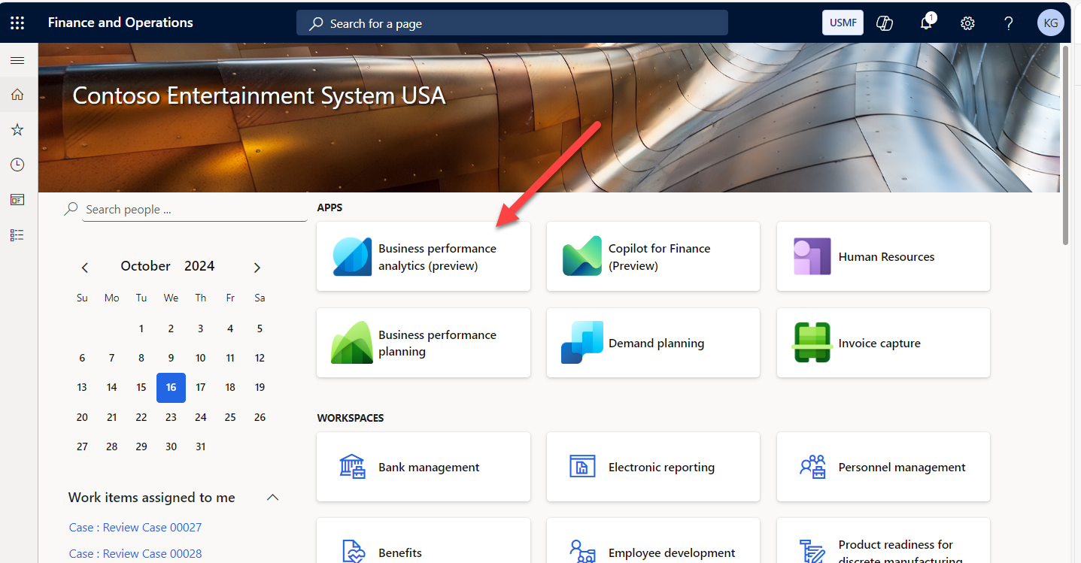

Slide 32
Business Performance Analytics
Balance Sheet
Budget vs Actual
Financial Performance
General Ledger Dimension Details
General Ledger Transaction Details
Profit and Loss
Purchase orders
Vendor Aging
Vendor Invoices
Vendor Payments
Vendor transaction details
Sales aging
Sales transaction details

Slide 33
Success Stories

Slide 34
Recap and Q&A

Slide 35
Suggested Resources
https://www.microsoft.com/en-us/power-platform/products/power-automate#Use-cases
https://10xds.com/blog/microsoft-power-platform-use-cases/
https://powerplatformer.com/13-use-cases-for-the-power-platform/
https://imperiumdynamics.com/blog/power-platform-use-cases-examples
https://ngenioussolutions.com/blog/microsoft-powerapps-use-cases/
https://learn.microsoft.com/en-us/dynamics365/finance/business-performance-analytics/configure-bpa?source=recommendations
https://learn.microsoft.com/en-us/dynamics365/finance/business-performance-analytics/reports-in-bpa?source=recommendations

Slide 36


Slide 37
AX/FINANCE & OPS
© 2024 Dynamic Communities. All rights reserved.

